Slide 1

Multithreading
The objectives of this chapter are:
To understand the purpose of multithreading
To describe Java's multithreading mechanism
To explain concurrency issues caused by multithreading
To outline synchronized access to shared resources

Slide 2

What is Multithreading?
Multithreading is similar to multi-processing.
A multi-processing Operating System can run several processes at the same time
  Each process has its own address/memory space
  The OS's scheduler decides when each process is executed
    Only one process is actually executing at any given time. However, the system appears to be running several programs simultaneously
Separate processes to not have access to each other's memory space
  Many OSes have a shared memory system so that processes can share memory space
In a multithreaded application, there are several points of execution within the same memory space.
  Each point of execution is called a thread
  Threads share access to memory

Slide 3
What is Multithreading?
Multithreading | Multitasking
Programming concept | Operating system concept
Supports execution of multiple parts of a single program simultaneously | Supports execution of multiple programs simultaneously
Processor has to switch between different parts or threads of a program. | Processor has to switch between different programs.
Highly efficient. | Less efficient
A thread is the smallest unit in multithreading | A program/process is the smallest unit in multitasking
Helps in developing efficient programs. | Helps in developing efficient OS.
Cost effective in case of context switching | Costly in case of context switching

Slide 4
Why use Multithreading?
In a single threaded application, one thread of execution must do everything
  If an application has several tasks to perform, those tasks will be performed when the thread can get to them.
  A single task which requires a lot of processing can make the entire application appear to be "sluggish" or unresponsive.
In a multithreaded application, each task can be performed by a separate thread
  If one thread is executing a long process, it does not make the entire application wait for it to finish.
If a multithreaded application is being executed on a system that has multiple processors, the OS may execute separate threads simultaneously on separate processors.

Slide 5
What Kind of Applications Use Multithreading?
Any kind of application which has distinct tasks which can be performed independently
  Any application with a GUI.
    Threads dedicated to the GUI can delegate the processing of user requests to other threads.
    The GUI remains responsive to the user even when the user's requests are being processed
  Any application which requires asynchronous response
    Network based applications are ideally suited to multithreading.
      Data can arrive from the network at any time.
      In a single threaded system, data is queued until the thread can read the data
      In a multithreaded system, a thread can be dedicated to listening for data on the network port
      When data arrives, the thread reads it immediately and processes it or delegates its processing to another thread

Slide 6
How does it all work?
Each thread is given its own "context"
  A thread's context includes virtual registers and its own calling stack
The "scheduler" decides which thread executes at any given time
  The VM may use its own scheduler
  Since many OSes now directly support multithreading, the VM may use the system's scheduler for scheduling threads
The scheduler maintains a list of ready threads (the run queue) and a list of threads waiting for input (the wait queue)
Each thread has a priority. The scheduler typically schedules between the highest priority threads in the run queue
  Note: the programmer cannot make assumptions about how threads are going to be scheduled. Typically, threads will be executed differently on different platforms.

Slide 7
Thread Support in Java
Few programming languages directly support threading
  Although many have add-on thread support
  Add on thread support is often quite cumbersome to use
The Java Virtual machine has its own runtime threads
  Used for garbage collection
Threads are represented by a Thread class
  A thread object maintains the state of the thread
  It provides control methods such as interrupt, start, sleep, yield, wait
When an application executes, the main method is executed by a single thread.
  If the application requires more threads, the application must create them.

Slide 8
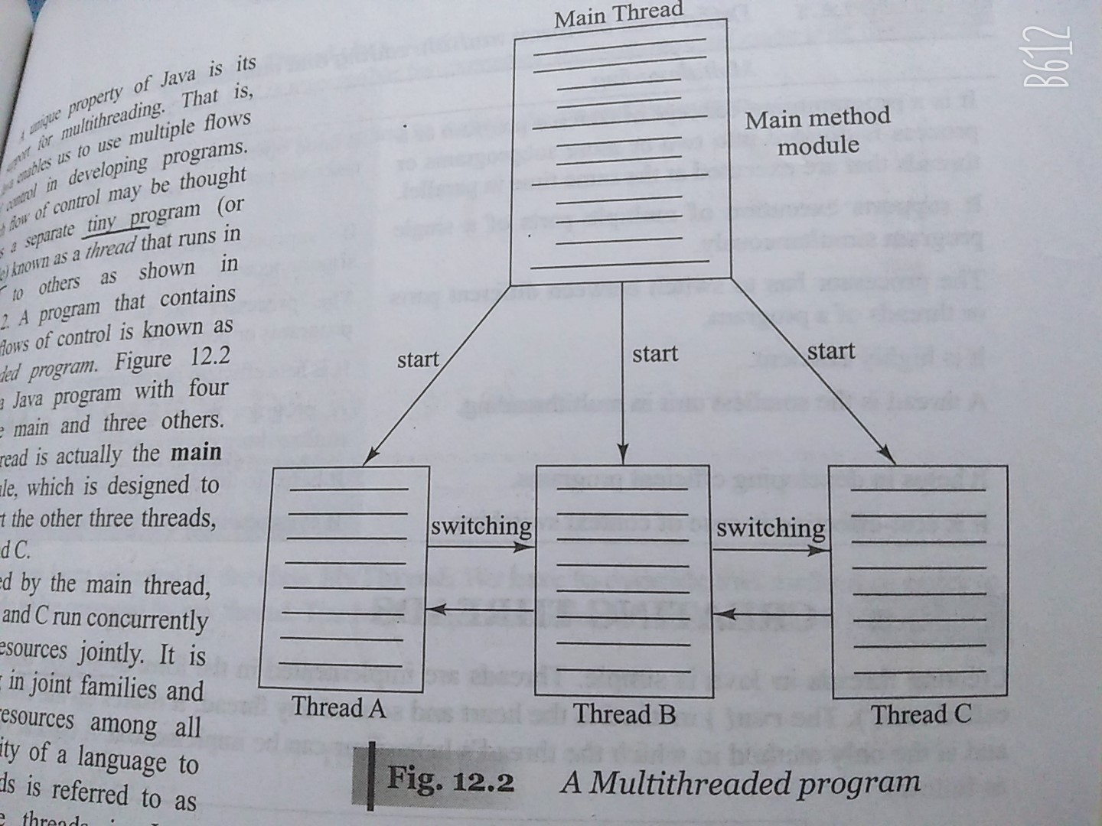
Thread Support in Java

Slide 9
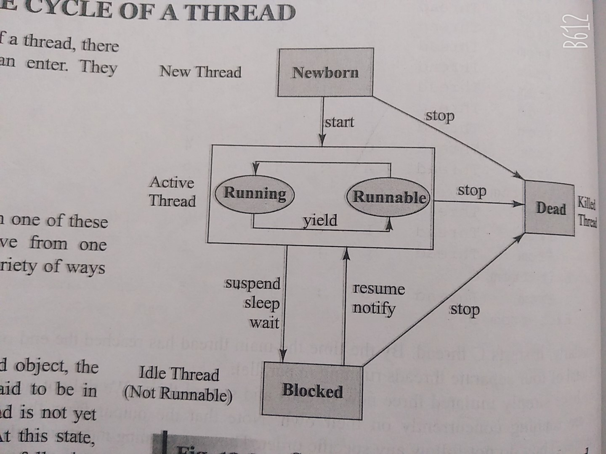
Thread life cycle

Slide 10
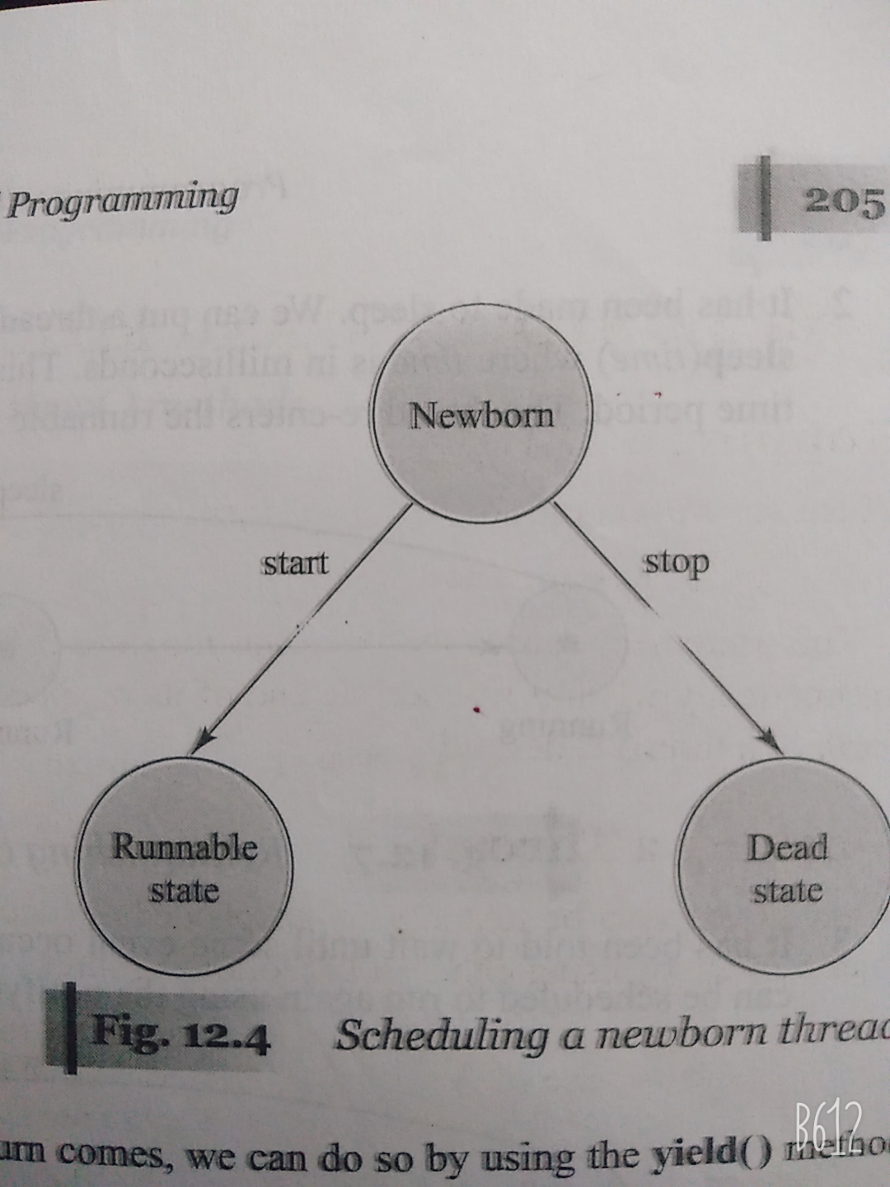
Thread life cycle

Slide 11
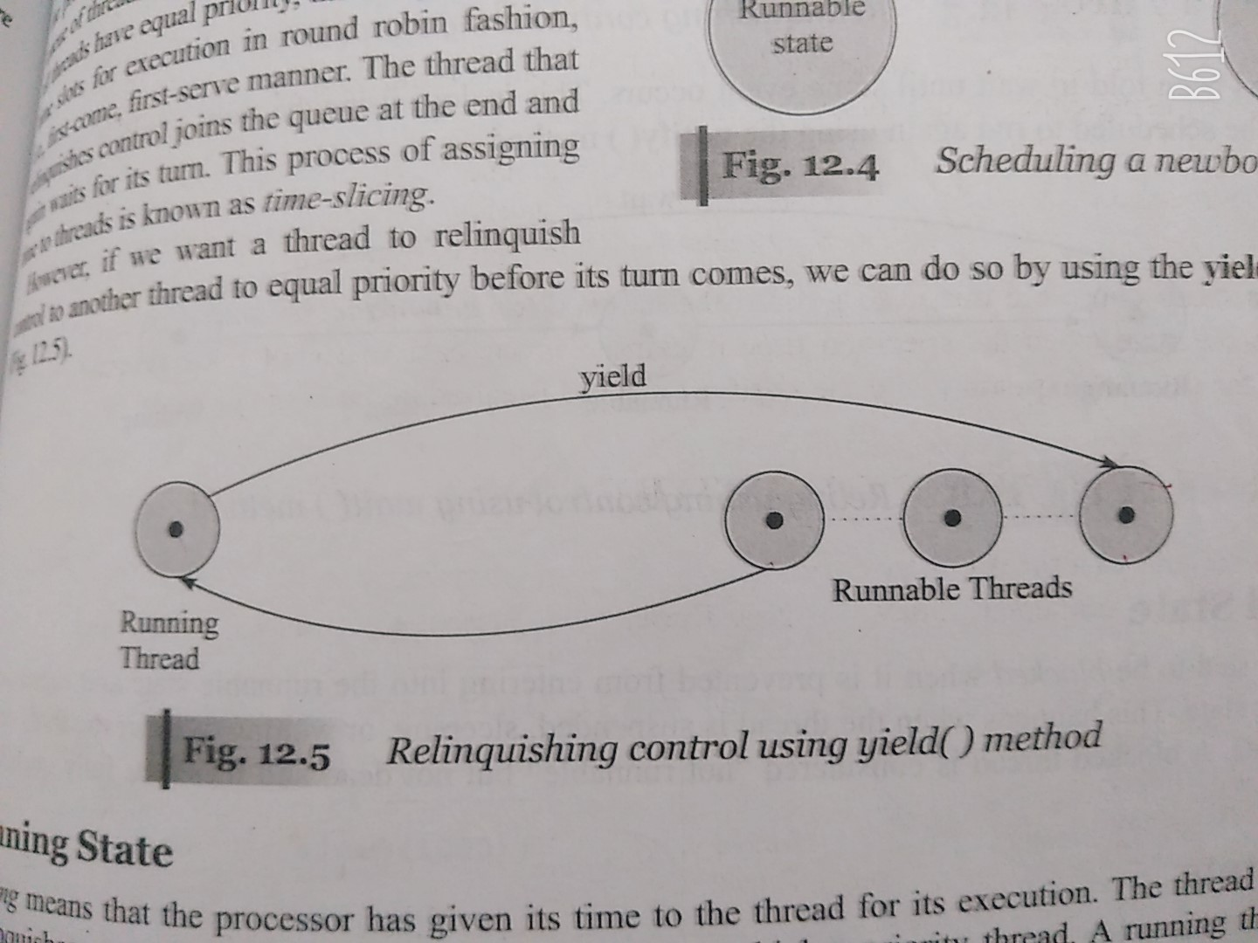
Thread life cycle

Slide 12
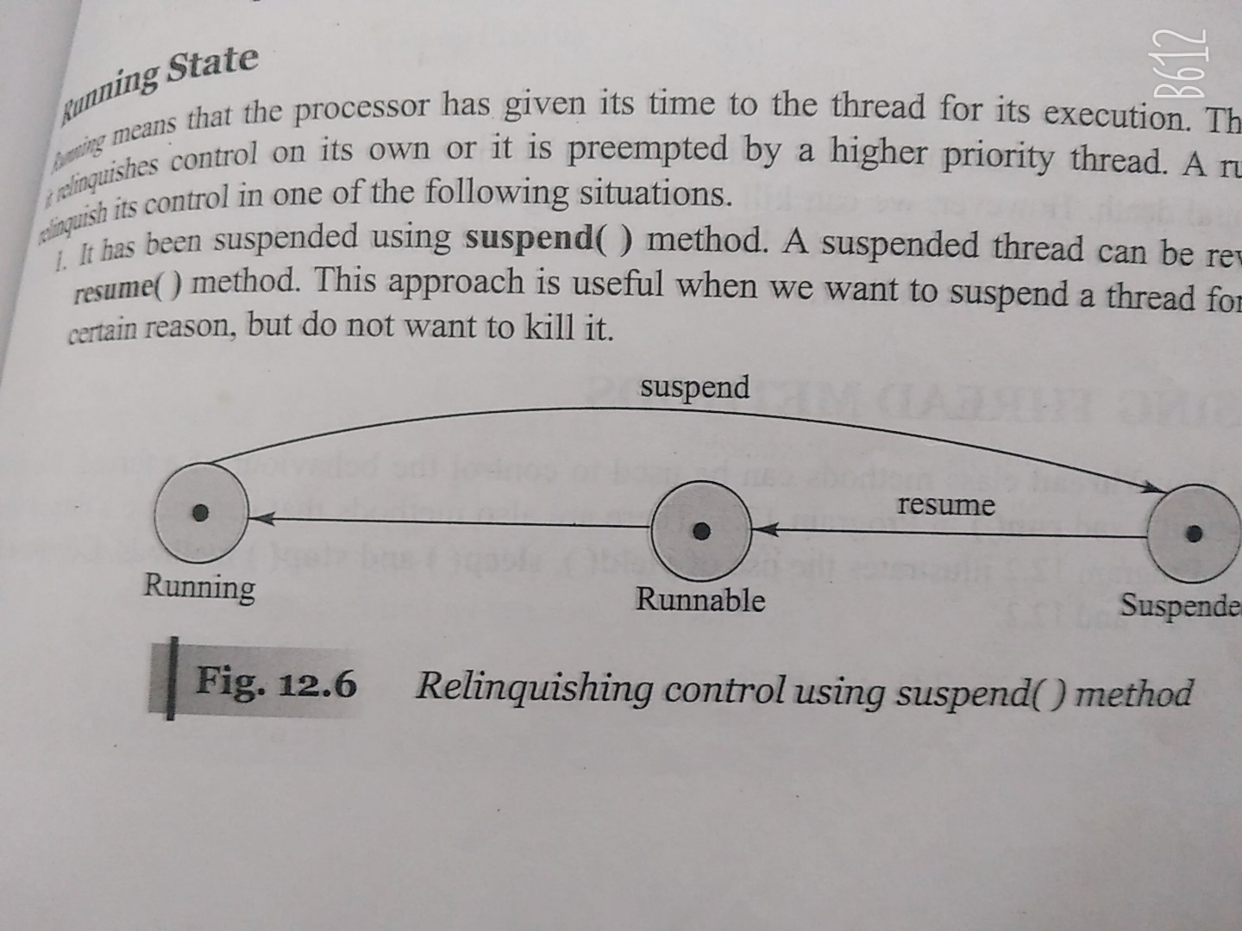
Thread life cycle

Slide 13
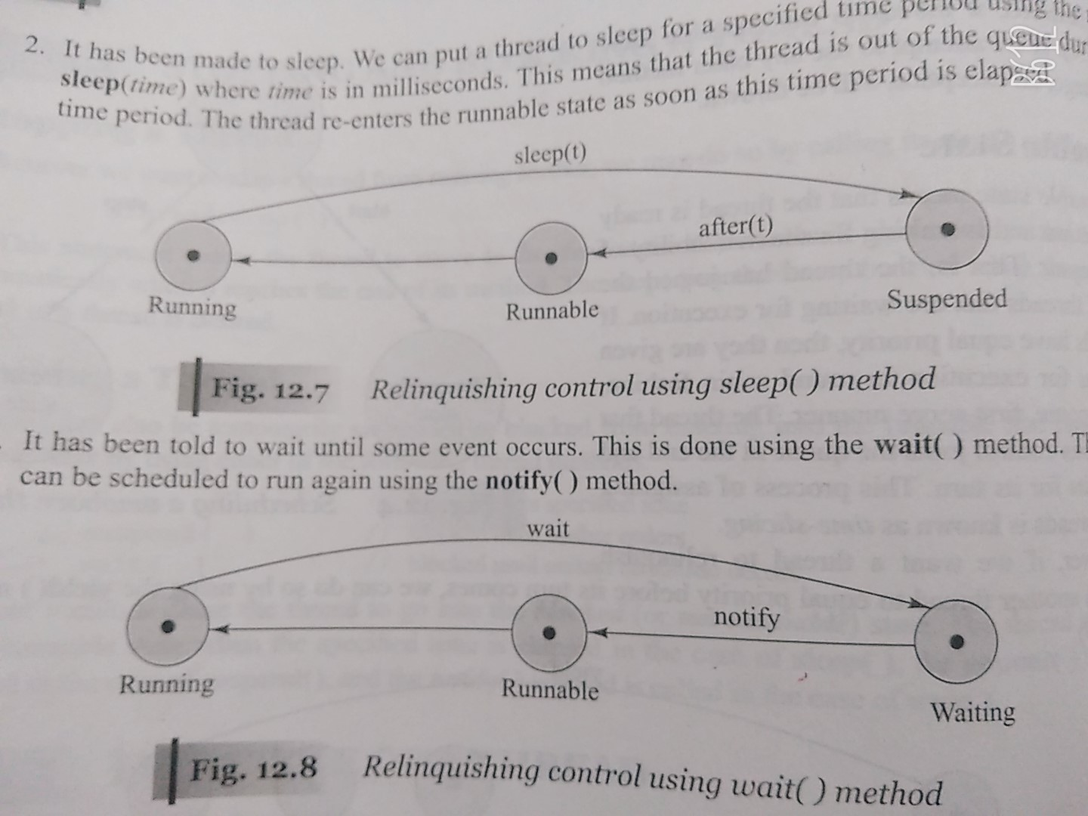
Thread life cycle

Slide 14
Creating your own Threads
There are two ways
1. The obvious way to create your own threads is to subclass the Thread class and then override the run() method
  This is the easiest way to do it
  It is not the recommended way to do it.
Because threads are usually associated with a task, the object which provides the run method is usually a subclass of some other class
  If it inherits from another class, it cannot inherit from Thread.
2. The solution is provided by an interface called Runnable.
  Runnable defines one method - public void run()
One of the Thread classes constructor takes a reference to a Runnable object
  When the thread is started, it invokes the run method in the runnable object instead of its own run method.

Slide 15
Creating your own Threads
By extending the Thread class: 3 steps
1. Declare the class as extending Thread class:
class MyThread extends Thread
{
…..
}
2.Implementing the run() method:
public void run()
{
………..//Thread code here
………..
}
3.Starting New Thread:
MyThread a= new MyThread();
a.start(); //invokes run() method

Slide 16
Example Code: By extending Thread class
class Multi extends Thread
{
public void run()
{
System.out.println("thread is running...");
}
}
Class abc
{
public static void main(String args[])
{
Multi t1=new Multi();
t1.start();
}
}

Slide 17
By extending Thread class
Write a program to create two threads Thread A and Thread B. Thread A displays the numbers from 1 to 7 and thread B displays days in a week. Create main method to call these two threads and display the output.

Slide 18
Creating your own Threads
By implementing the “Runnable”interface: 4 steps
1. Declare the class by implementing Runnable interface:
class MyThread implements Runnable
{
…..
}
2.Implementing the run() method:
public void run()
{
………..//Thread code here
………..
}
3.Create a thread by defining an object that is instantiated from this “runnable” class as the target of the thread.
MyThread a= new MyThread();
Thread x=new Thread(a);
4. Call the thread’s start() method to run the thread.
x.start(); //invokes run() method

Slide 19
Using Runnable
In the example below, when the Thread object is instantiated, it is passed a reference to a "Runnable" object
  The Runnable object must implement a method called "run"
When the thread object receives a start message, it checks to see if it has a reference to a Runnable object:
  If it does, it runs the "run" method of that object
  If not, it runs its own "run" method
Thread1
start()
Thread2
Thread Object
Runnable Object
run()
run()

Slide 20
Example using Runnable interface
class Multi3 implements Runnable
{
public void run()
{
System.out.println("thread is running...");
}
public static void main(String args[])
{
Multi3 m1=new Multi3();
Thread t1 =new Thread(m1);
t1.start();
}
}

Slide 21
Properly Terminating Threads
In Java 1.1, the Thread class had a stop() method
  One thread could terminate another by invoking its stop() method.
  However, using stop() could lead to deadlocks
  The stop() method is now deprecated. DO NOT use the stop method to terminate a thread
The correct way to stop a thread is to have the run method terminate
  Add a boolean variable which indicates whether the thread should continue or not
  Provide a set method for that variable which can be invoked by another thread

Slide 22
Creating Multiple Threads
The previous example illustrates a Runnable class which creates its own thread when the start method is invoked.
If one wished to create multiple threads, one could simple create multiple instances of the Runnable class and send each object a start message
  Each instance would create its own thread object
Is the a maximum number of threads which can be created?
  There is no defined maximum in Java.
  If the VM is delegating threads to the OS, then this is platform dependent.
  A good rule of thumb for maximum thread count is to allow 2Mb of ram for each thread
    Although threads share the same memory space, this can be a reasonable estimate of how many threads your machine can handle.

Slide 23
public void run(): is used to perform action for a thread.
public void start(): starts the execution of the thread.JVM calls the run() method on the thread.
public void sleep(long milliseconds): Causes the currently executing thread to sleep (temporarily cease execution) for the specified number of milliseconds.
public void join(): waits for a thread to die.
public void join(long milliseconds): waits for a thread to die for the specified miliseconds.
public int getPriority(): returns the priority of the thread.
public int setPriority(int priority): changes the priority of the thread.
public String getName(): returns the name of the thread.
public void setName(String name): changes the name of the thread.
public Thread currentThread(): returns the reference of currently executing thread.
Thread(Runnable threadobj,String threadName)

Slide 24
public int getId(): returns the id of the thread.
public Thread.State getState(): returns the state of the thread.
public boolean isAlive(): tests if the thread is alive.
public void yield(): causes the currently executing thread object to temporarily pause and allow other threads to execute.
public void suspend(): is used to suspend the thread(depricated).
public void resume(): is used to resume the suspended thread(depricated).
public void stop(): is used to stop the thread(depricated).
public void interrupt(): interrupts the thread.
public boolean isInterrupted(): tests if the thread has been interrupted.
public static boolean interrupted(): tests if the current thread has been interrupted.

Slide 25
Thread Priorities
Every thread is assigned a priority (between 1 and 10)
  The default is 5
  The higher the number, the higher the priority
  Can be set with setPriority(int aPriority)
The standard mode of operation is that the scheduler executes threads with higher priorities first.
  This simple scheduling algorithm can cause problems. Specifically, one high priority thread can become a "CPU hog".
  A thread using vast amounts of CPU can share CPU time with other threads by invoking the yield() method on itself.
Most OSes do not employ a scheduling algorithm as simple as this one
  Most modern OSes have thread aging
    The more CPU a thread receives, the lower its priority becomes
    The more a thread waits for the CPU, the higher its priority becomes
  Because of thread aging, the effect of setting a thread's priority is dependent on the platform

Slide 26
Thread Program
Write a program in Java to create two threads thread A and thread B. Thread A stores an array of characters whereas Thread B stores an array of numbers. Make them run concurrently and display characters and numbers.

Slide 27
Synchronized block in java
Synchronized block can be used to perform synchronization on any specific resource of the method.
synchronized (object reference expression) {
//code block
}

Slide 28
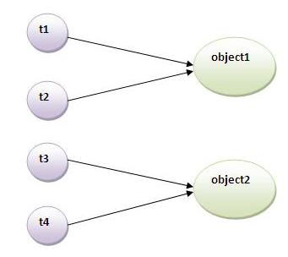

Slide 29
Thread Synchronization:
There are two types of thread synchronization mutual exclusive and inter-thread communication.
1.Mutual Exclusive
  Synchronized method.
  Synchronized block.
  static synchronization.
2.Cooperation (Inter-thread communication in java)

Slide 30
How does a Thread run?
The thread class has a run() method
  run() is executed when the thread's start() method is invoked
The thread terminates if the run method terminates
  To prevent a thread from terminating, the run method must not end
  run methods often have an endless loop to prevent thread termination
One thread starts another by calling its start method
  The sequence of events can be confusing to those more familiar with a single threaded model.
Thread1
start()
Thread2
Thread Object
run()

Slide 31
Terminating Thread Example
public class Test implements Runnable
{
private Thread theThread;
private boolean stopThread = false;
public void start()
{
if (theThread == null)
{
theThread = new Thread(this);
theThread.start();
}
}
public void setStopThread(boolean aValue)
{
stopThread = aValue;
}
public void run()
{
while(true)
{
if (stopThread)
break;
// ....
}
}

Slide 32
Yield() and Sleep()
Sometimes a thread can determine that it has nothing to do
  Sometimes the system can determine this. ie. waiting for I/O
When a thread has nothing to do, it should not use CPU
  This is called a busy-wait.
  Threads in busy-wait are busy using up the CPU doing nothing.
    Often, threads in busy-wait are continually checking a flag to see if there is anything to do.
It is worthwhile to run a CPU monitor program on your desktop
  You can see that a thread is in busy-wait when the CPU monitor goes up (usually to 100%), but the application doesn't seem to be doing anything.
Threads in busy-wait should be moved from the Run queue to the Wait queue so that they do not hog the CPU
  Use yield() or sleep(time)
  Yield simply tells the scheduler to schedule another thread
  Sleep guarantees that this thread will remain in the wait queue for the specified number of milliseconds.

Slide 33
Concurrent Access to Data
Those familiar with databases will understand that concurrent access to data can lead to data integrity problems
  Specifically, if two sources attempt to update the same data at the same time, the result of the data can be undefined.
  The outcome is determined by how the scheduler schedules the two sources.
    Since the schedulers activities cannot be predicted, the outcome cannot be predicted
Databases deal with this mechanism through "locking"
  If a source is going to update a table or record, it can lock the table or record until such time that the data has been successfully updated.
  While locked, all access is blocked except to the source which holds the lock.
Java has the equivalent mechanism. It is called synchronization
  Java has a keyword called synchronized

Slide 34
Synchronization
In Java, every object has a lock
  To obtain the lock, you must synchronize with the object
The simplest way to use synchronization is by declaring one or more methods to be synchronized
  When a synchronized method is invoked, the calling thread attempts to obtain the lock on the object.
    if it cannot obtain the lock, the thread goes to sleep until the lock becomes available
  Once the lock is obtained, no other thread can obtain the lock until it is released. ie, the synchronized method terminates
  When a thread is within a synchronized method, it knows that no other synchronized method can be invoked by any other thread
    Therefore, it is within synchronized methods that critical data is updated

Slide 35
Providing Thread Safe Access to Data
If an object contains data which may be updated from multiple thread sources, the object should be implemented in a thread-safe manner
  All access to critical data should only be provided through synchronized methods (or synchronized blocks).
  In this way, we are guaranteed that the data will be updated by only one thread at a time.
public class SavingsAccount
{
private float balance;
public synchronized void withdraw(float anAmount)
{
if ((anAmount>0.0) && (anAmount<=balance))
balance = balance - anAmount;
}
public synchronized void deposit(float anAmount)
{
if (anAmount>0.0)
balance = balance + anAmount;
}

Slide 36
Thread Safety Performance Issues
However, there is an overhead associated with synchronization
  Many threads may be waiting to gain access to one of the object's synchronized methods
  The object remains locked as long as a thread is within a synchronized method.
  Ideally, the method should be kept as short as possible.
Another solution is to provide synchronization on a block of code instead of the entire method
  In this case, the object's lock is only held for the time that the thread is within the block.
  The intent is that we only lock the region of code which requires access to the critical data. Any other code within the method can occur without the lock.
  In high load situations where multiple threads are attempting to access critical data, this is by far a much better implementation.

Slide 37
Block Synchronization
public class SavingsAccount
{
private float balance;
public void withdraw(float anAmount)
{
if (anAmount<0.0)
throw new IllegalArgumentException("Withdraw amount negative");
synchronized(this)
{
if (anAmount<=balance)
balance = balance - anAmount;
}
}
public void deposit(float anAmount)
{
if (anAmount<0.0)
throw new IllegalArgumentException("Deposit amount negative");
synchronized(this)
{
balance = balance + anAmount;
}
}

Slide 38
Inter Thread Communication
Inter-thread communication or Co-operation is all about allowing synchronized threads to communicate with each other.
Cooperation (Inter-thread communication) is a mechanism in which a thread is paused running in its critical section and another thread is allowed to enter (or lock) in the same critical section to be executed.
It is implemented by following method of Object class:
wait()
notify()
notifyAll()

Slide 39
wait()-Causes current thread to release the lock and wait until either another thread invokes the notify() method or the notifyAll() method for this object, or a specified amount of time has elapsed.
public final void wait()throws InterruptedException
public final void wait(long timeout)throws InterruptedException

Slide 40
notify() method Wakes up a single thread that is waiting on this object's monitor. If any threads are waiting on this object, one of them is chosen to be awakened. The choice is arbitrary and occurs at the discretion of the implementation
public final void notify()
notifyAll() method Wakes up all threads that are waiting on this object's monitor.
public final void notifyAll()

Slide 41
Interrupting a Thread:
If any thread is in sleeping or waiting state (i.e. sleep() or wait() is invoked), calling the interrupt() method on the thread, breaks out the sleeping or waiting state throwing InterruptedException.
If the thread is not in the sleeping or waiting state, calling the interrupt() method performs normal behaviour and doesn't interrupt the thread but sets the interrupt flag to true.
public void interrupt()
public static boolean interrupted()
public boolean isInterrupted()

Slide 42
Join method:
Thread class provides the join() method which allows one thread to wait until another thread completes its execution. If t is a Thread object whose thread is currently executing, then t. join() will make sure that t is terminated before the next instruction is executed by the program.
Why we use join() method?
In normal circumstances we generally have more than one thread, thread scheduler schedules the threads, which does not guarantee the order of execution of threads.

Slide 43
Join method:
Without using join()
Here we have three threads th1, th2 and th3. Even though we have started the threads in a sequential manner the thread scheduler does not start and end them in the specified order. Everytime you run this code, you may get a different result each time.
The same example with join()
Lets say our requirement is to execute them in the order of first, second and third. We can do so by using join() method appropriately.

